Slide 1
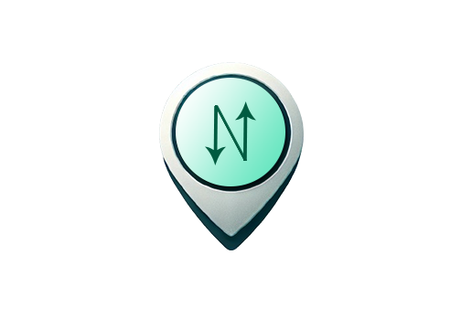
Redesigning Pittsburgh’s Bus Stop Signs and Transit App
INFSCI 1430: User Experience Engineering
Fall 2024
AJSKL: Adeel Piracha, Jenny Wang, Sharif Dahdaleh, Kaden Jackson, Lexi Shainoff

Slide 2
Introduction
Problem statement
Navigating public transportation is confusing and inefficient
Commuters face missed connections, delays, and a lack of reliable information
Motivation
Growing need for smarter transit solutions
NexusTrip simplifies public transport, improving accessibility, and efficiency
Scope and objectives of the project
Real-time transit updates, integrated transport services (buses, trains, bike-share), optimized routes based on user needs
Encourage sustainable travel through better transit solutions
Improve accessibility

Slide 3

Transit Base Features
Maps integration
Where To? Search bar
Bus tracking
Ticket purchasing
Route options
Overall a mostly easy-to-use UI

Slide 4


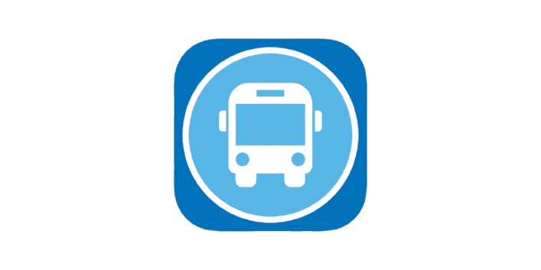
Competitive Landscape Analysis
Citymapper
Moovit
Pittsburgh Bus Tracker
Number of Downloads: 10+ million on Google Play
User Ratings: 4.9 stars on the App Store, 4.8 stars on Google Play
Advertised as an app offering "All Live Transit."
Provides live tracking of bus, subway, and train times.
Includes public walking, bike, and scooter routes.
Specific bus stop information
100+ million on Google Play
User Ratings: 4.6 stars on the App Store, 4.1 stars on Google Play
Tracks all live transit
Main features include “Directions”, “Stations”, and “Lines”
Main issue was too many ads, especially full screen ads.
App Store Only
User Ratings: 4.4 Stars
Designed specifically for tracking Pittsburgh bus routes.
Target Audience - Residents of Pittsburgh who use public transport regularly.
Tracks specific buses and/or stops
Very unfriendly user interface

Slide 5
User Needs Analysis
Unreliable Transit Updates
Outdated or inconsistent information
Complicated Route Planning
Difficulty connecting multiple services
Missed Alerts
Lack of timely notifications for delays or changes
Cluttered Apps
Overwhelming interfaces that are hard to use

Slide 6
01
Design Iteration #1

Slide 7
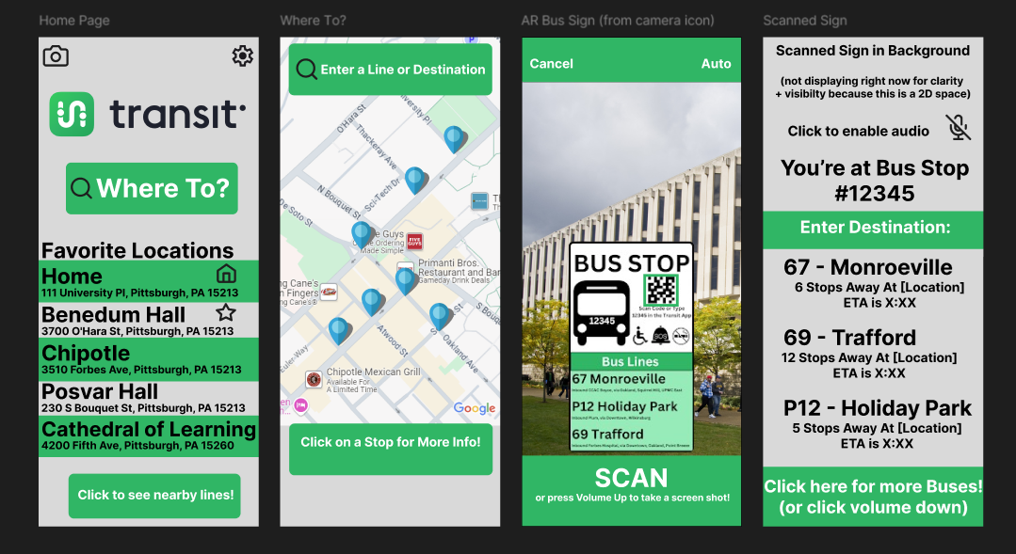
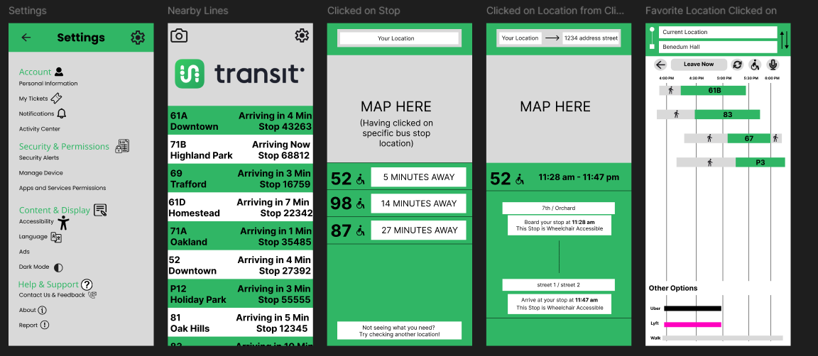
Wireframes
Scanned Sign
AR Bus Sign
Home Page
Settings

Slide 8
Wireframes
Where To?
Home Page
Favorite Location Clicked On
Nearby Lines

Slide 9
Wireframes
Where To?
Clicked on Stop
Clicked on Location from Clicked on Stop

Slide 10
Design Justification
Favorite Locations Feature
Users can save frequently visited locations for quick access on the home screen
Reduces time and enhances conveniences for users with regular travel patterns
Route Optimization Tool
Interactive route planner with options to filter by time, cost, and mode of transport
Helps users plan efficiently, meeting their desire for personalization and integration of multiple modes of transportation.

Slide 11
User Testing Results
Overview of Testing Protocol
Conducted usability test using a prototype of NexusStop (Transit)
Participants completed key tasks navigating routes and purchasing tickets
Participant Demographics
2x 5 participants (age range: 20 - 22 years old)
About 50% were occasional or frequent users)
Key Findings
Positive Feedback
User appreciated the simple navigation bar, live updates, and settings page
Areas for Improvement
Cluttered on some areas, some users requester a clearer route summary
Back buttons

Slide 12
Design Improvements
Remove Clutter
Simplifying text and removing redundant information. For example:
Removing the addresses from the home page
Making the information clearer on the nearby lines page
Standardized background color
Some screens were grey while others were white
Added Map to nearby line page
This allowed for information to be displayed more effectively
This also meant we can add the line’s info on the map similar to the Transit app
General improvements to readability and user-experience

Slide 13
02
Design Iteration #2

Slide 14
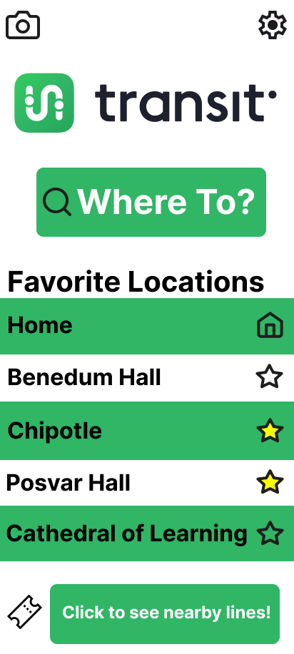
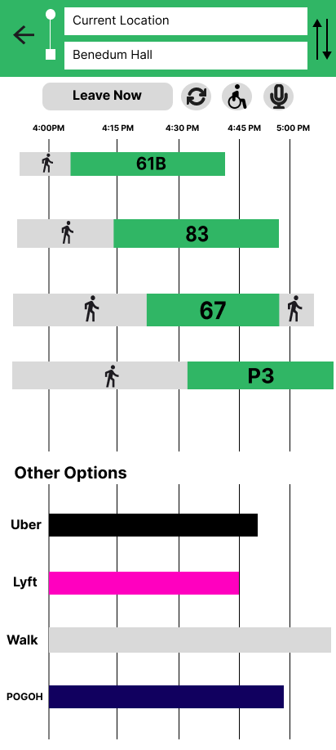
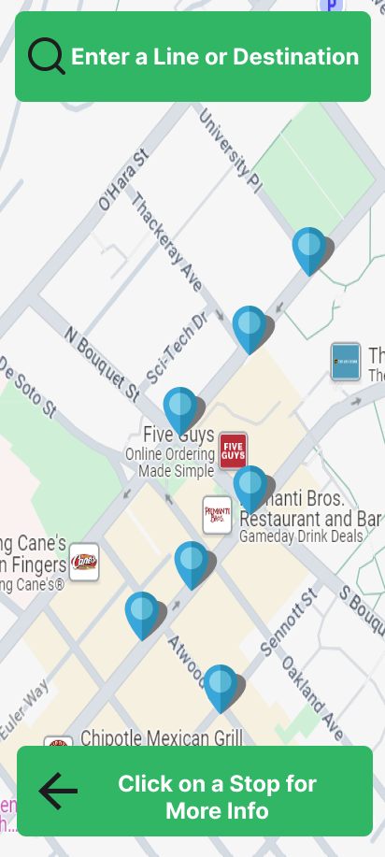
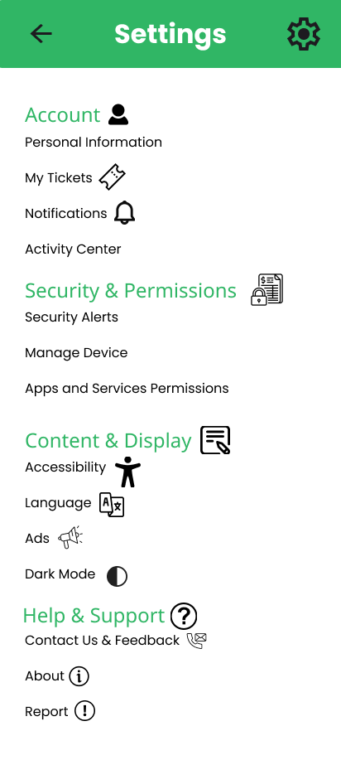
Wireframes

Slide 15
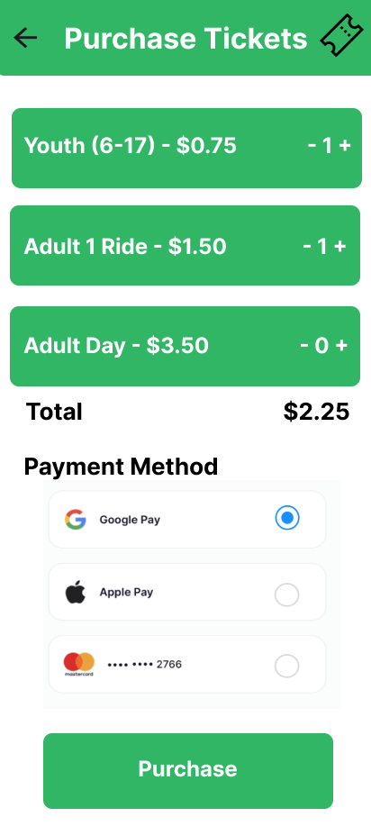
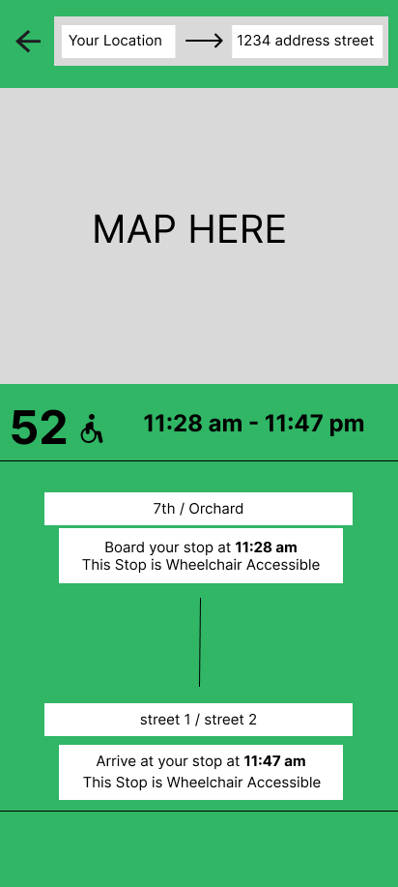
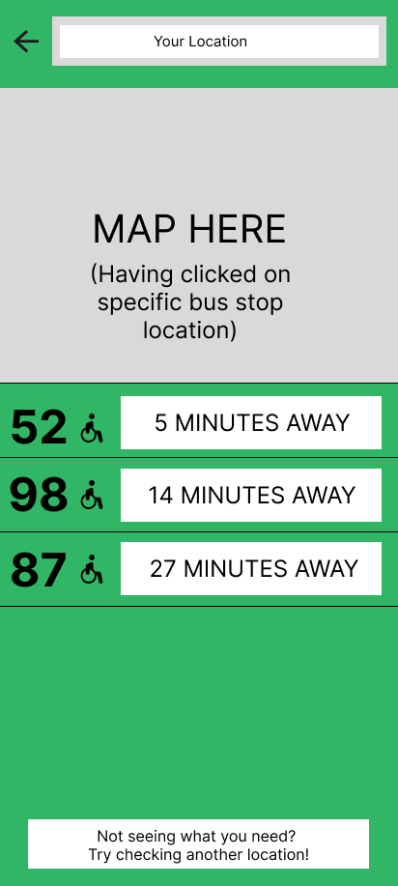
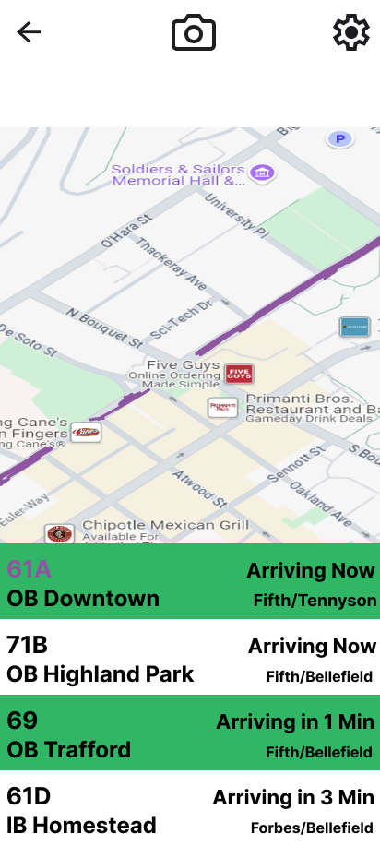
Wireframes

Slide 16
Design Justification
Seamless Transition
Wanted to keep as much of our original design as possible while translating to Android Studio
Make visuals pop out and not be cluttered
Make the flow between screens clear and not confusing for users
Make Screens more Uniform in Design
Keep Green and White and don’t get “fancier”

Slide 17
User Testing Results
Simplify Design
Remove unnecessary icons on settings page
Make icons and components larger for visibility
Have clearer mechanisms for interactive features of the app
More Clear Flow
Link a page of prior tickets to tickets page
Make Inbound vs Outbound more clear on the Nearby Lines screen
Make Accessibility Options more Prominent

Slide 18

Final Design Improvements

Slide 19
Lessons Learned
Iteration 1 Challenges:
Getting all of the information we wanted to display and show off into a minimal amount of screens
Creating a design that preserves the strengths of Transit’s design without completely redefining it
Lessons
Make design less cluttered + simplify the visual display
Make the flow easy for users to navigate through
Iteration 2 Challenges:
Getting Android Studio and Flutter to work and translating our design from Figma frames to code
Integrate the .json schedule and Google Maps API
Lessons
Increase prominence of accessibility options
Improved clarity for inbound/outbound toggles.
General Reflections:
Importance of good communication and delegating tasks
Key lessons for future UX projects
Iterate on ideas to see what can be improved
Importance of incorporating user feedback when going through design

Slide 20
Conclusion
How the redesign addresses the problem statement
The Redesign tackles common frustrations like unclear routes and options, outdated info, confusing and cluttered interfaces in a more user friendly application
Final Impact
NexusTrip makes public transportation easier to use by improving accessibility and simplifying the experience of using an app for aide.
Recommendations for Future Work
Get Google Maps API fully working for app
Integrate bus_schedule.json file into routes and bus lines information
Expand design to include extra needed screens and features

Slide 21
Thanks!
Any Questions?

